Slide 1
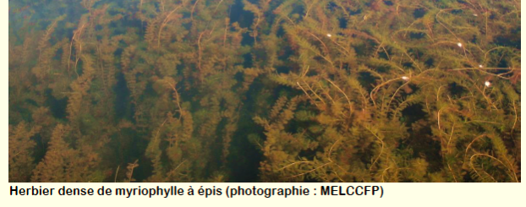
Plan d’action contrer le myriophylle / Milfoil Action Plan 2025 Produit avec le soutien du fonds vert de la Pêche / produced with support from the La Peche Green Fund
Présentation pour l’Assemblée annuelle / Presentation for the Annual Meeting
Association des lacs Notre-Dame et Usher / Lac Notre-Dame and Usher Lake Association
5 Juillet 2025 / July 5, 2025
Notes:
Thanks for joining today
We’re here to talk about how the association is responding to the milfoil issue facing all of us on lac notre-dame
Le myriophylle à épis est une plante aquatique envahissante persistante / Eurasian Milfoil is a persistent invasive aquatic plant
Réduit la biodiversité / Reduces biodiversity
Diminue les niveaux d'oxygène dans l'eau / Diminishes oxygen levels in the water
Peut créer des eaux stagnantes, un habitat idéal pour les moustiques / Can create stagnant water, an ideal habitat for mosquitoes
Entrave les activités de loisirs comme la natation, la navigation de plaisance et la pêche / Hinders recreational activities like swimming, boating and fishing
Fait baisser la valeur des propriétés / Drives down property values
Se propage rapidement et facilement / Spreads quickly and easily

Slide 2
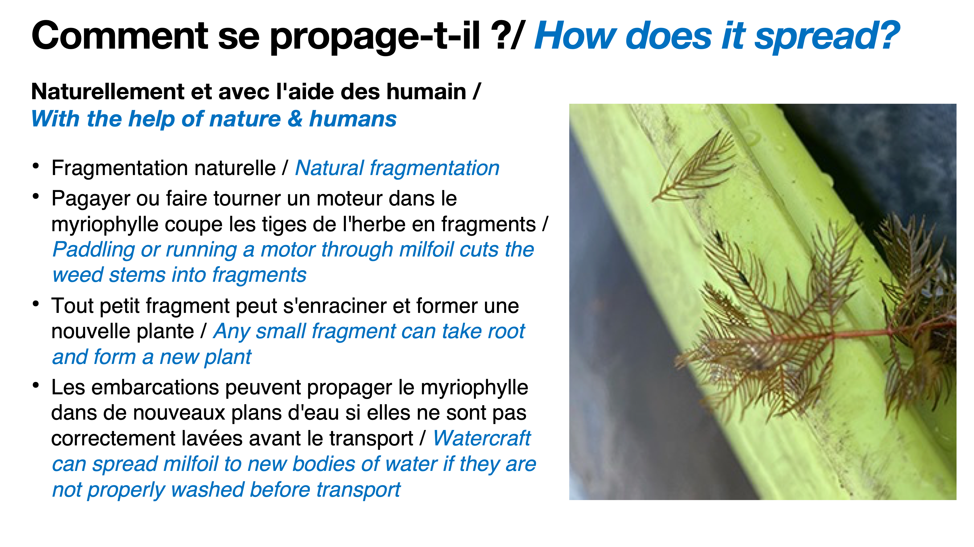
Notes:
Le myriophylle à épis est une plante aquatique envahissante persistante / Eurasian Milfoil is a persistent invasive aquatic plant
When humans disturb the plant, the weed can spread, and often does. It’s the most common way.
Yes, there is a natural process of propagation. But it is accelerated by our activities on the water.
If it gets bad enough, and I think most of us agree that is where we are headed, the outcomes are not great:
Réduit la biodiversité / It Reduces biodiversity
Diminue les niveaux d'oxygène dans l'eau / Diminishes oxygen levels in the water
Peut créer des eaux stagnantes, un habitat idéal pour les moustiques / It Can create stagnant water, an ideal habitat for mosquitoes
Entrave les activités de loisirs comme la natation, la navigation de plaisance et la pêche / It Hinders recreational activities like swimming, boating and fishing
Fait baisser la valeur des propriétés /It Drives down property values
And it can damage the motor of any boat on the lake.

Slide 3
Méthodes de lutte / Control Methods (Gouverment du Québec, 2023)
Méthode / Method | Efficacité / Efficacy | Coût / Cost
Inaction | + Déclin naturel est possible sans intervention - Déclin et effet environmental difficiles à prévoir + Natural decline is possible - Decline and environmental effects unpredictable | Nul / None
Arrachage Manuel / Manual Removal | + Efficace si bien fait - Requiert plongeurs spécialisés et aspirateur pour fragments + Effective if done right - Requires specialized divers and vacuum for fragments | Faible pour l’équipement Très élevé pour la main-d’oeuvre Low for equipment Very high for labor
Toile synthétique / Synthetic fabric | + Réutilisables + Très efficace - Entretien annuel - Effets sur faune et flore lors de l’installation + Reusable + Highly efficient - Annual maintenance - Effects on flora and fauna during installation | Élevé pour équipement et main d’oeuvre High for equipment and labor

Slide 4
Méthodes de lutte / Control Methods (Gouverment du Québec, 2023)
Méthode / Method | Efficacité / Efficacy | Coût / Cost
Toile de jute / Burlap | + Très efficace +/- Installation simple mais à refaire - Effets sur faune et flore inconnus + Highly efficient +/- Simple installation but must be repeated - Unknown effects on flora and faun | Modéré pour équipement et pas de main d’oeuvre professionnelle requise Moderate for equipment and no professional labour required
Faucardage / Cutting | +/- Effets immédiats mais de courte durée - Effets sur faune et flore - Risque de propagation du myriophylle +/- Immediate but short-term effects - Effects on flora and fauna - Risk of milfoil propagation | Peu élevé si fait “à la main” Très élevé pour équipement et main d’oeuvre Low if done “by hand” Very high for equipment and labour
Herbicide | + Rapide - Peu de choix de produits au Canada - Effets considérables sur la faune et la flore + Fast - Little choice of products in Canada - Considerable impact on flora and fauna | Élevé pour les produits High for products

Slide 5
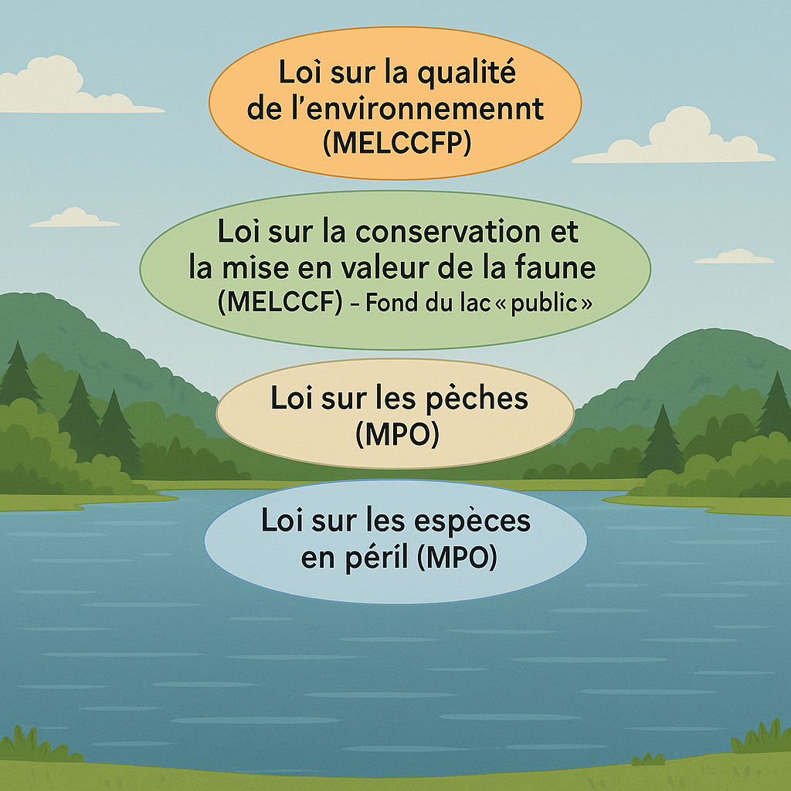
Réglementation et authorizations / Regulations and authorizations
Quatre lois limitent les interventions possibles pour réduire ou enrayer le myriophylle sur les lacs publics (comme le Lac Notre-Dame) au Québec /
Four laws limit the interventions that can be carried out to reduce or control milfoil on public lakes (such as Lac Notre-Dame) in Quebec
Ces lois déterminent si des autorisations gouvernementales sont nécessaires avant de faire une intervention à petite ou grande échelle, selon la méthode employée /
These laws determine whether government authorizations are required before any small- or large-scale intervention can be carried out, depending on the method employed
Même si une loi ne nécessite pas d’autorisation, une autre peut l’obliger car les lois ne protègent pas tous les mêmes aspects de l’environnement /
Even if one law doesn't require authorization, another may, since not all laws protect the same aspects of the environment
Notes:
Loi sur la qualité de l’environnement (MELCCFP) / Environmental Quality Act (MELCCFP)
Loi sur la conservation et la mise en valeur de la faune (MELCCF) – Fond du lac « public » / Wildlife Conservation and Development Act (MELCCF)
Loi sur les pêches (MPO) / Fisheries Act (DFO)
Loi sur les espèces en péril (MPO) / Species at Risk Act (DFO).

Slide 6
Résumé des exigences réglementaires en matière d'autorisation / Summary of regulatory authorization requirements Oui = autorisation requise Non = aucune autorisation requise Yes = authorization required No = no authorization required
 | Toile biodégradable / Biodegradable fabric | Toile synthétique / Synthetic fabric | Manual removal / Arrachage manuel
Loi sur la qualité de l’environnement (MELCCFP) / Environmental Quality Act | + 75 m2 = Oui / Yes - 75 m2 = Non/ No | + 75 m2 = Oui / Yes - 75 m2 = Non/ No | Non / No
Loi sur la conservation et la mise en valeur de la faune (MELCCF) / Wildlife Conservation and Development Act | Oui / Yes | Oui / Yes | Oui / Yes
Loi sur les pêches (MPO) / Fisheries Act (DFO) Loi sur les espèces en peril (MPO) / Species at Risk Act (DFO) | Oui / Yes | Oui / Yes | Oui / Yes
*** Important: Pour tout type de coupe (manuelle ou mécanique), quelle qu'en soit la taille, les autorisations provinciales sont obligatoires et peu susceptibles d'être accordées /
*** Important: For any type of cutting (manual or mechanical), no matter the size, provincial authorizations are obligatory and unlikely to be given
Notes:
The co-op RAPPEL which the Association belongs to, prepared this chart that summaries when government authorizations are required to either MANUALLY REMOVE WEED or TARP sections of the lake.
This chart is consistent with what we heard from government official from the province and municipality.
Review each section.
We will be exploring all the option for further mitigation and report back to you. Right now we can tell you it will be expensive, time-consuming, with no guarantee of success.
There are many things we cannot do right now, but we can share with our neighbours information about how milfoil spreads, the importance of cleaning up cuttings, and saying out of milfoil. And that is why we will be going door-to-door to speak with our neighbours.

Slide 7

Plan d’action contre le myriophylle / Milfoil Action Plan
Il s'adresse à tous et toutes / It’s for everyone
Il concerne l'avenir du lac / It’s about the future of the lake
Malheureusement, il n'y a pas de solution miracle / Sadly, there is no silver bullet
Il est nécessaire d'informer et de promouvoir les lignes directrices dans notre communauté / Information about and promotion of the Guidelines is needed across the community
Une campagne de porte-à-porte est prévue les 19 et 20 Juillet / Door-to-door canvass planned for July 19 & 20
Voulez-vous vous joindre à nous ? Inscrivez-vous ! / Would you like to join us? Please sign up!
Notes:
The action plan for this summer includes some things we have done in the past, but in a more intensive way. For example, we will be deploying more buoys to mark the expanding milfoil fields.
Everyone can contribute to making this action plan work, and we hope you will.
You can:
Gather and dispose of cuttings on your shoreline or on the water. This is very important
Wash your watercraft regularly to ensure you carry no cuttings when you go on the water
You can join the Association and contribute to the work we are doing together.
Milfoil has been in the lake for 30 years. It won’t disappear any time soon. We need to work together and change the way we use the lake to make a difference.
The Association is planning to:
Continue water testing and data analysis to monitor the lake for weed-feeding nutrients
Explore ways to monitor and address the presence of toxic blue-green algae
Encourage property owners to restore their waterfronts to a more natural state to limit runoff that contains nutrients that feed the weed and make sure their septic systems are in good working order
Recognize the need to protect wetlands on the lake, in compliance with provincial legislation and municipal regulations.
Solicit expert advice from Dr. Paul Hamilton of the Canadian Museum of Nature and RAPPEL, a co-op of freshwater experts, to help design our milfoil mitigation strategy.
We also want to present the Board’s plan to introduce Watercraft Guidelines for everyone to follow.

Slide 8
Notes:
This is about slowing the spread of the weed and making the lake clearer.
It is based on the Lac Gauvreau experience where a similar approach was taken with positive results.
The Guidelines are about steering everyone who uses the lake away from the milfoil bed and toward open water.
EXPLAIN THE MAP
It is very likely this map will be tweaked based on feedback from the survey. Changes will be minor and will include adjustments to
I know many of you already boat cautiously when it comes to the milfoil, but many don’t. I see them every time I spend time at the dock.

Slide 9

Qu’en penses les résidents et résidentes? / What do residents think?
Sondage du Comité d’action pour contrer le myriophylle dans les lacs Notre-Dame et Usher de l’Été 2025 / Lac Notre-Dame and Usher Lake Association Summer 2025 Milfoil Action Plan Survey
111 invitations par courriel envoyées dès le 18 juin 2025 / 111 email invitations sent starting on June 18, 2025
57 participants = 51% de taux de participation / 57 participants = 51% participation rate
Notes:
As mentioned, we have widely consulted lake residents about the watercraft guidelines, including many who operate boats big and small on the lake. The consultation included a survey of residents about the watercraft guidelines, which drew the participation of about half of those for whom we have email addresses. I am pleased to share some of the results with you today. We plan to post a full survey report on the website. If you would like to receive the report, please include your email address on the sign in sheet.
We had responses from all around the lake with the exception of one area just northwest of the Manor Point.
People reported seeing milfoil in all areas of the lake.
And 78% reported milfoil on their shoreline last summer. Only 13% reported no milfoil.
Turning to other highlights from the survey.

Slide 10
L'année dernière, la situation du myriophylle sur les rives était pire ou à peu près la même par rapport aux années précédentes / Last year’s shoreline milfoil was worse or about the same compared to previous years
Compared to previous years, was the milfoil growing along your property’s shoreline last summer:
42 responses

Slide 11
La plupart des riverains et riveraines sont très inquiets / Most lake residents are very concerned
Overall, how concerned are you about the presence of milfoil on Lac Notre-Dame? 54 Responses

Slide 12
Les loisirs et l'impact sur l'environnement sont en tête de liste des préoccupations / Recreation and environmental impacts top the list of concerns
What are your concerns about the presence of milfoil on Lac Notre-Dame? Please choose all that apply:
53 Responses

Slide 13
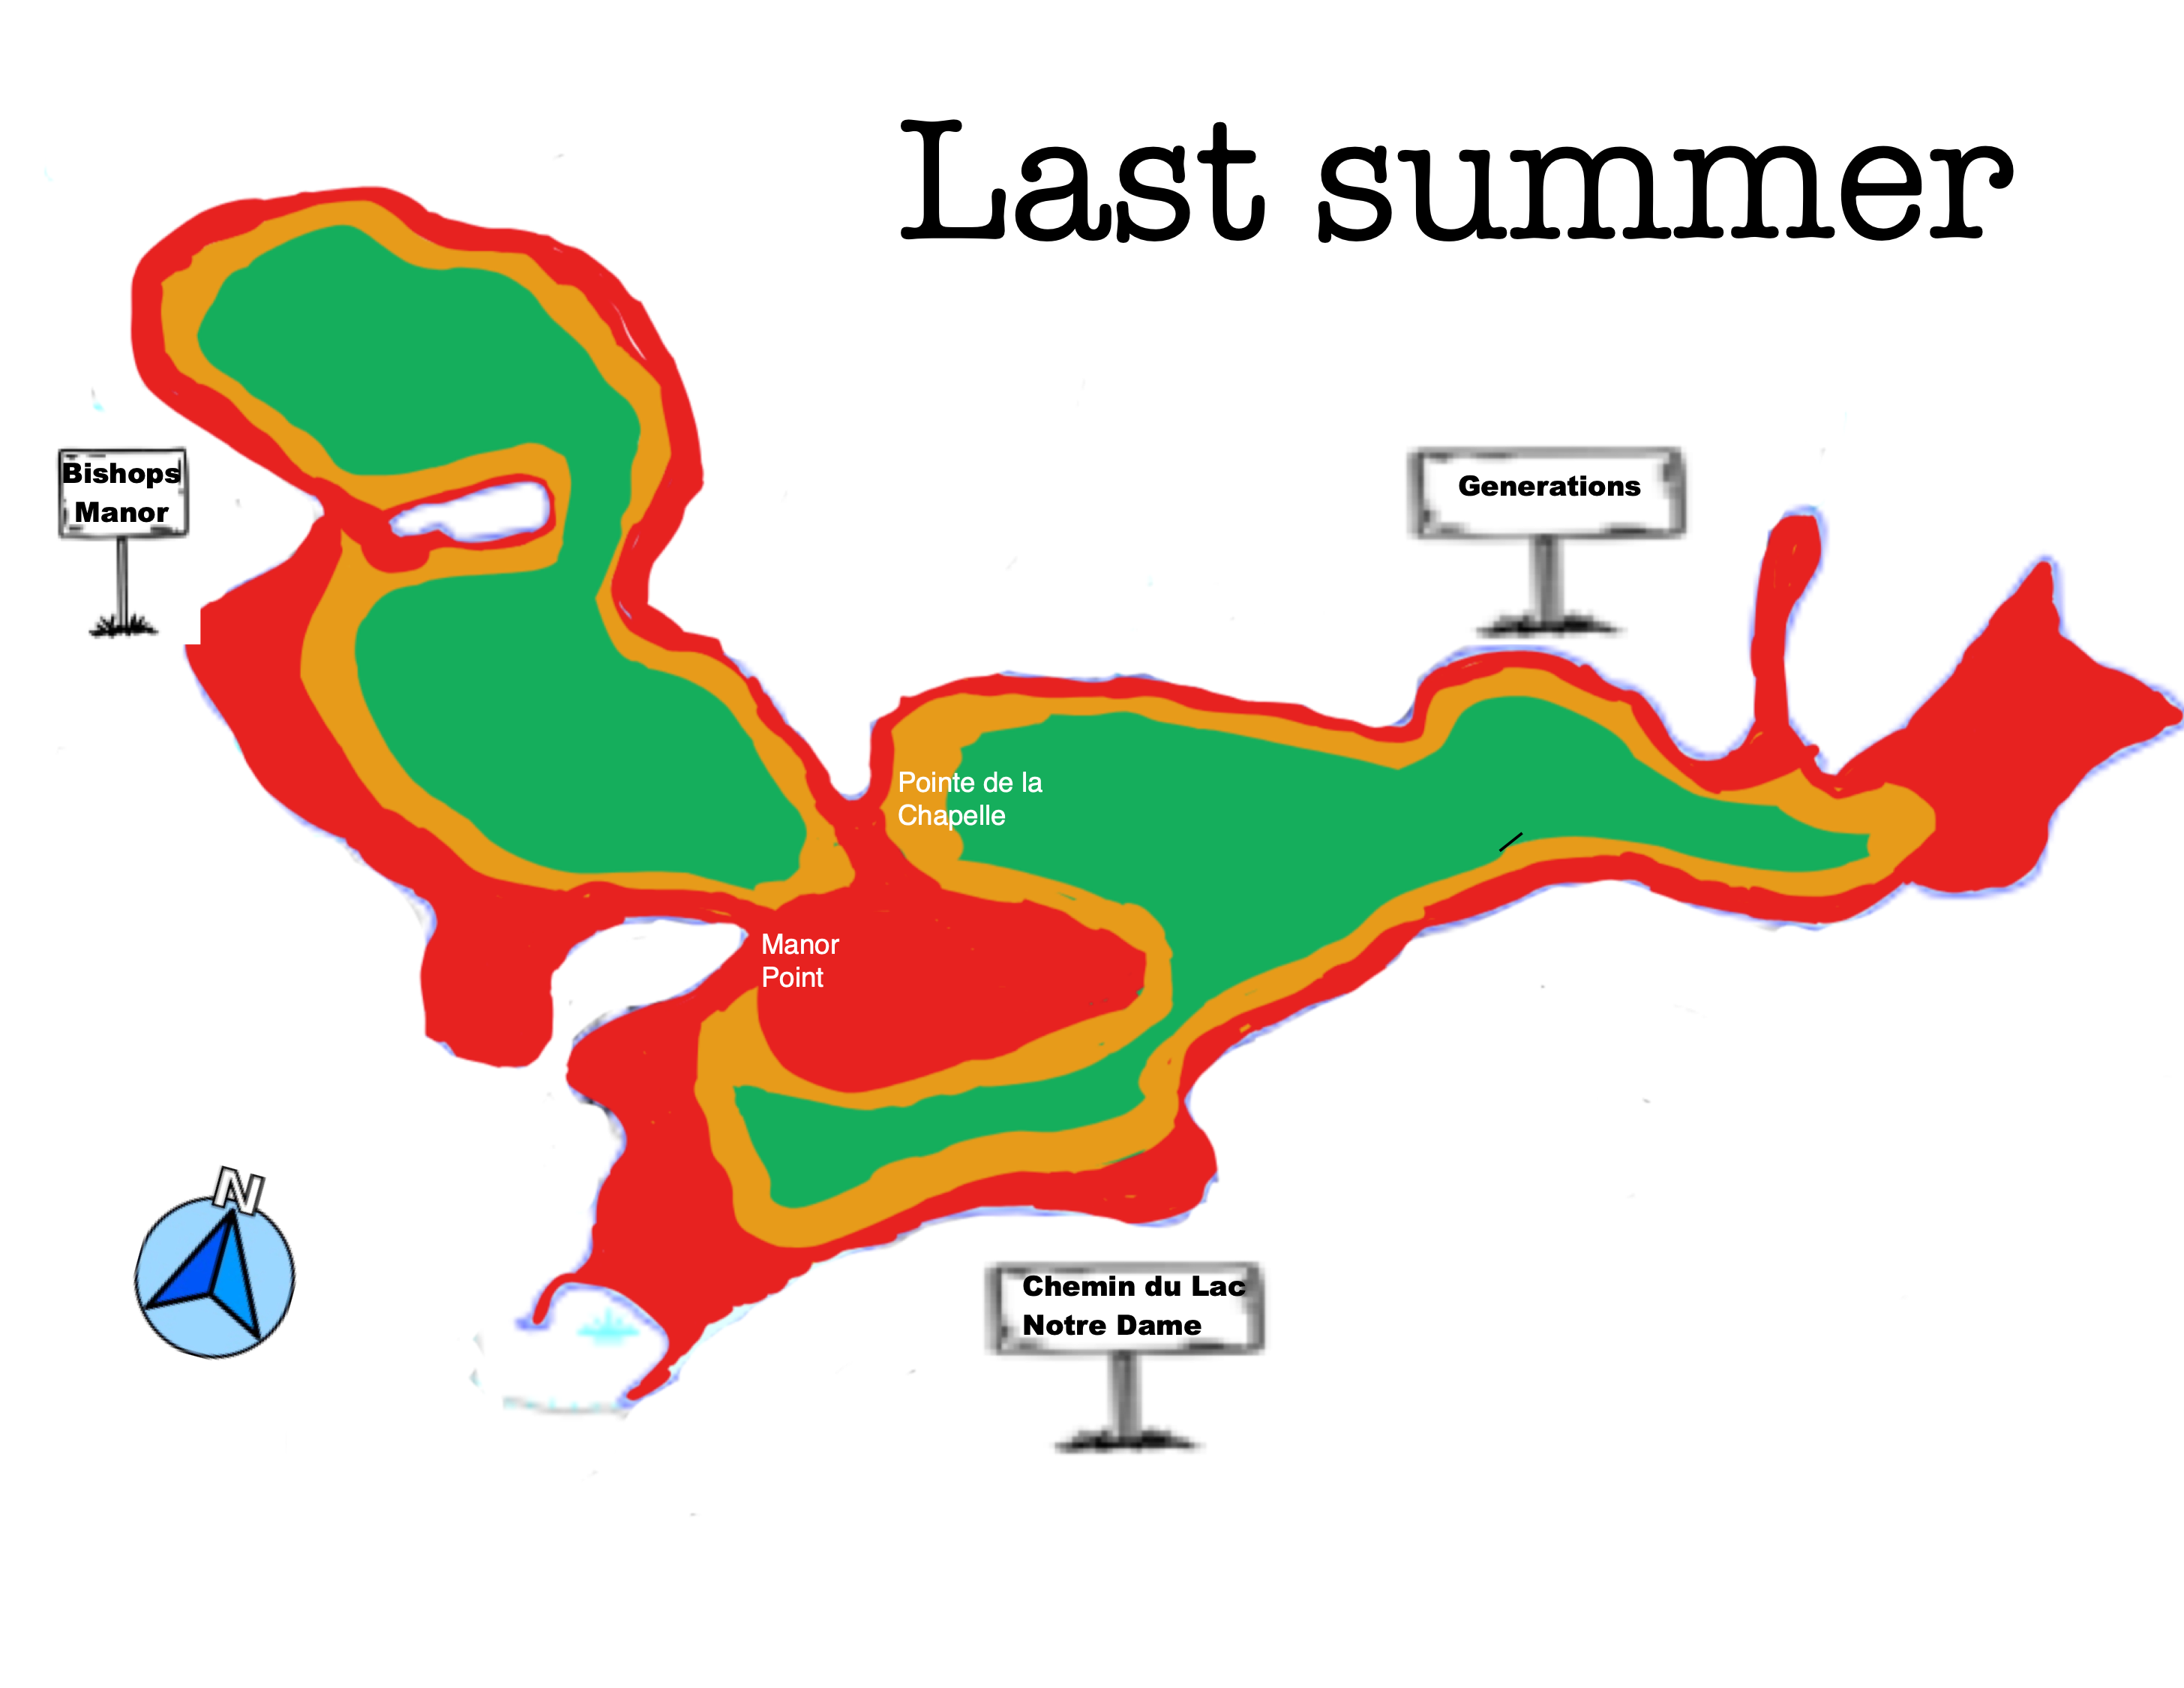
La plupart des personnes interrogées s'accordent à dire que la carte des lignes directrices est exacte / Most agree the guidelines map is accurate
Compared to the consultation map, based on your own experience on Lac Notre-Dame in the summer of 2024, the milfoil was:
53 responses

Slide 14


Les lignes directrices sont une bonne idée que la grande majorité d'entre elles prévoient de suivre / Guidelines are a good idea the vast majority plan to follow
98%
88%
Do you agree / disagree with the following statements?:
The voluntary Watercraft Guidelines are a good idea to slow the spread of milfoil on Lac Notre-Dame.
Even though they are voluntary, I plan to follow the Watercraft Guidelines to the best of my ability.
50 responses

Slide 15
Mais, moins convaincus que les autres suivront les lignes directrices / But, not as certain others will follow the guidelines
Do you agree / disagree with the following statement?:
I anticipate that other community members will follow the voluntary Watercraft Guidelines to the best of their ability.
50 responses

Slide 16
Qu’en pensez-vous? Parlons-en!
What do you think? Let's talk about it!

